Slide 1
Fraud Detection Dataset (Bank)
Hanif Dwi Satria
DS32A+

Slide 2
Table of contents
01
02
Business Understanding
Data Understanding
03
04
Data Preparation
Modeling & Evaluation
05
06
Feature Importance
Conclusion & Recommendation

Slide 3

About me
Experience
July - August 2024
Internship Trainee
Badan Pusat Statistik
Education
Hanif Dwi Satria
Linkedin
February 2025 - Now
Data Science Bootcamp
Dibimbing
November - December 2024
Data Analyst Bootcamp
MySkill

Slide 4
Recent Project
Exploratory Sales Data with Data Manipulation
Link
Analyzing some of handling data that error and also solving some of business problem about sales and quantity in each segment.
Tools : Python, Visualization tools in Python
Customer Segmentation with RFM Analysis
Link
Analyzing some of typical customer based on their transaction with some of business problem and handling some of error data
Tools : Python, Visualization tools in Python

Slide 5
01
Business Understanding

Slide 6
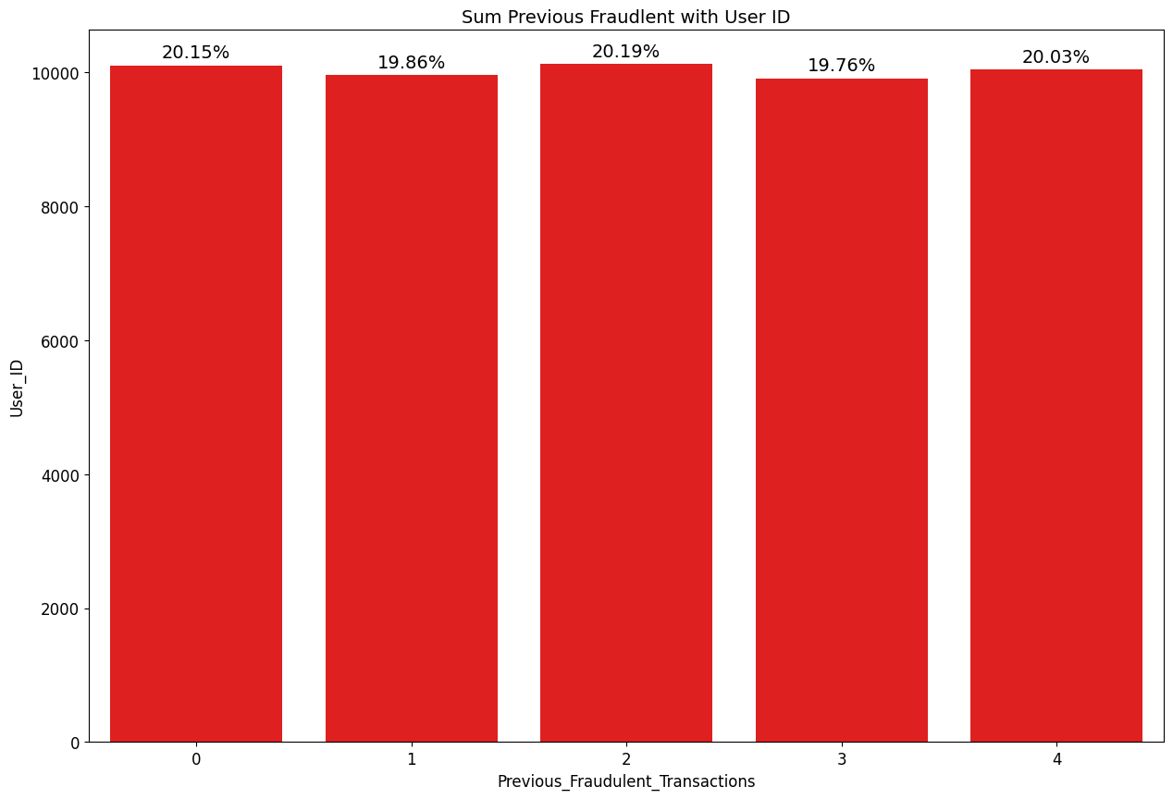

Background
Transaction is a method always people do for pulling the money from ATM, Transferring or anything else. But in this lately, the manipulated transaction is always haunted for all of the people. Based on graph, More people doing the previous raud, the probability to get fraud is getting big. So in this case, we have to analyze why this situation is already exist.

Slide 7
Objective & Business Problem
Objective : To get know some of feature importance that really indicated to the fraud situation with Model of Machine Learning. From the objective, we hope that we can determined which model can detect the potential fraud from that feature.
Business Problem :
If there's a lot of time of transaction from time to time, is there any possible for getting more fraud ?
Is there any correlation from each category column (Transaction_type, device_used, etc.) ? Also, is there any correlation from each that components for possibly to fraud ?
From the location, is there any big difference for each location of fraud ?
How was the distribution of customer age with fraud ? is it more higher or low to get fraud ?

Slide 8
02
Data
Understanding

Slide 9

Understanding Data
Dataset from kaggle, with the content of customer transaction
Information data like Transaction ID, User ID, Transaction Amount, Transaction Type, Time of Transaction, Device Used, Location, Previous Fraudulent Transactions, Account Age, Number of Transactions Last 24H, Payment Method, Fraudulent
Contain 51.000 data with 12 columns

Slide 10
03
Data Preparation

Slide 11
Preprocessing Data
Step 4
Split and Encoding Label
Step 1
Handling
Duplicate
Step 2
Handling
Missing Value
Step 3
Handling Outlier
There’s a Duplicate, with more than 1000
Change the NULL and ‘Unknown Device’ into something features with mod or med technique
Two outliers, but the boxplot its still clear
Split 80:20, label with One Hot Encoding.
Link Colab : link

Slide 12
Preprocessing Data
Step 5
Imbalanced Handling in Train
Step 6
Scaling
Step 7
Modeling and Evaluation
Undersampling and Stratify
Scaling with MinMaxScaler
Random Forest, Logistic, XGB, and Decision Tree with Metric F1-Score and Precision-Recall

Slide 13
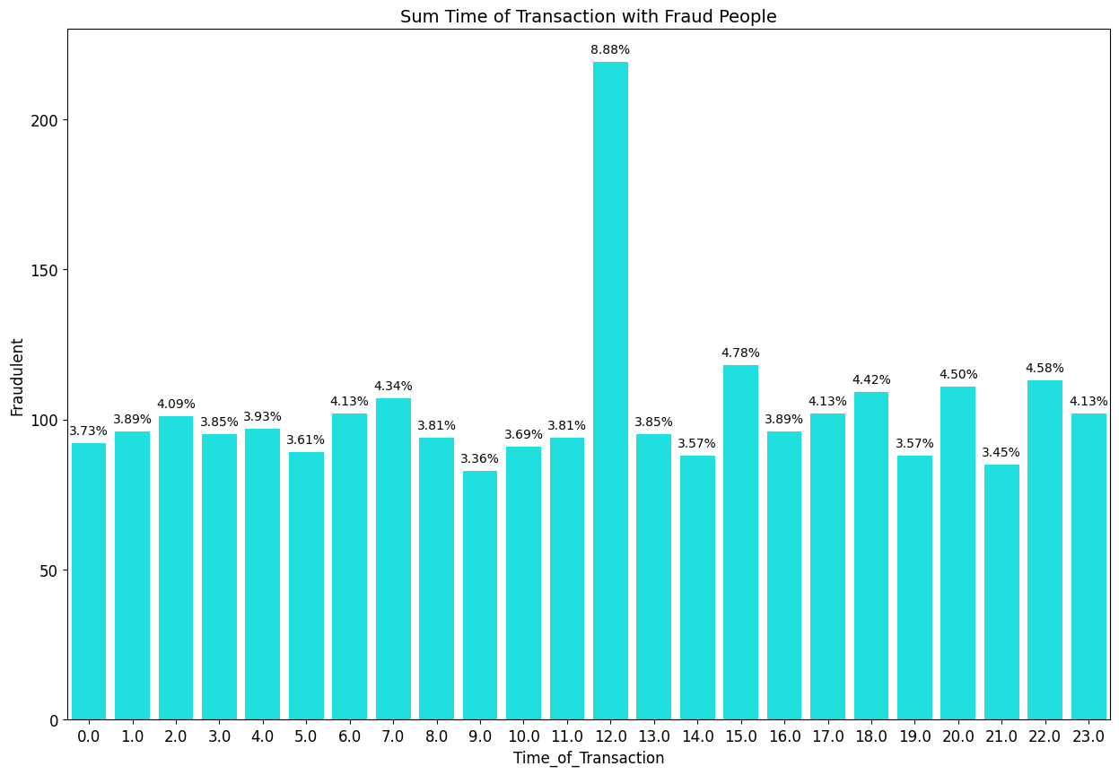
Exploratory Data Analysis (EDA)
If there's a lot of time of transaction from time to time, is there any possible for getting more fraud ?
Insight :
As you can see, the more time of transaction, the inconsistent of fraud would be. For the highest is on 12 o’clock with 8.88 % (green). For the lowest is on 9 o’clock with 3.36 % (red)

Slide 14
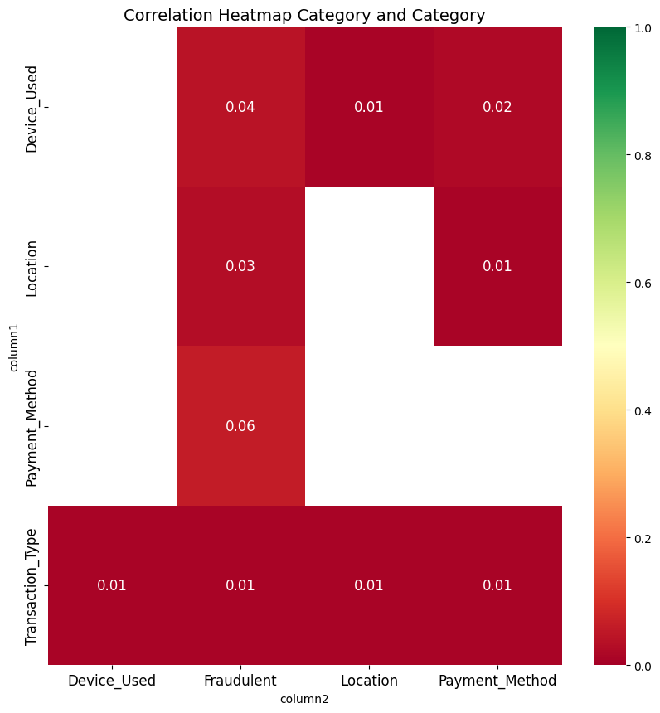
Exploratory Data Analysis (EDA)
2. Is there any correlation from each category column (Transaction type, Device used, Location, and Payment Method) ? Also, is there any correlation from each that components for possibly to fraud ?
Insight :
Based on that 4 category column, the highest and lowest is on (payment method & device) and the other is small with 0.02 and 0.01. It’s correlated but in weakest point. Also with fraud, the highest and lowest is on payment method and transaction type with 0.06 and 0.03. It’s correlated but in weakest one.

Slide 15
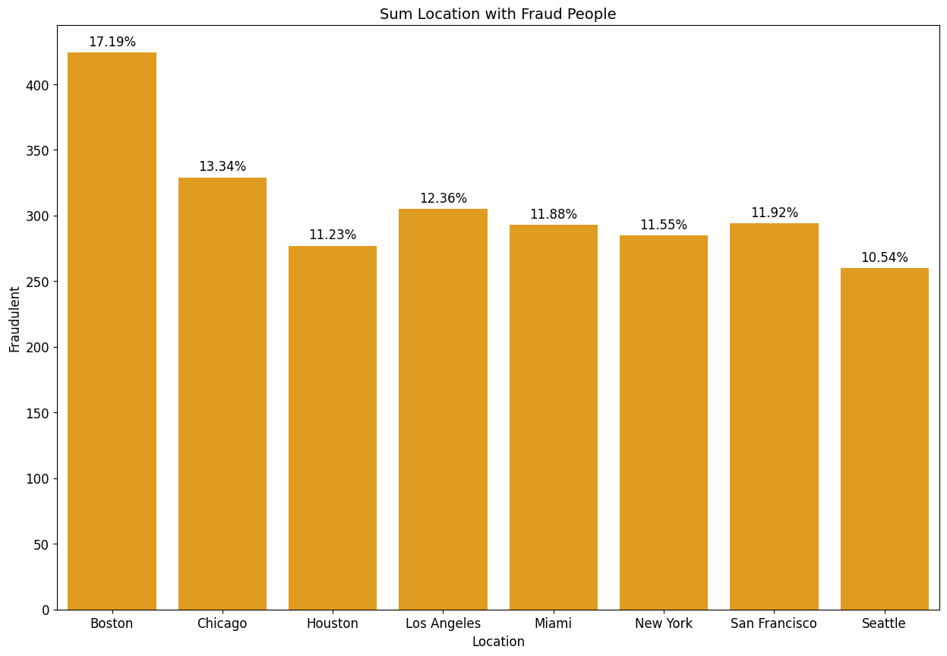
Exploratory Data Analysis (EDA)
2. From the location, is there any big difference for each location of fraud ?
Insight :
Based on that graph, the difference for each location with fraud is not very huge. It just only 1 % or less for difference. The highest is on Boston with 17.19 % (green) and the lowest is on seattle with 10.19 % (red)

Slide 16
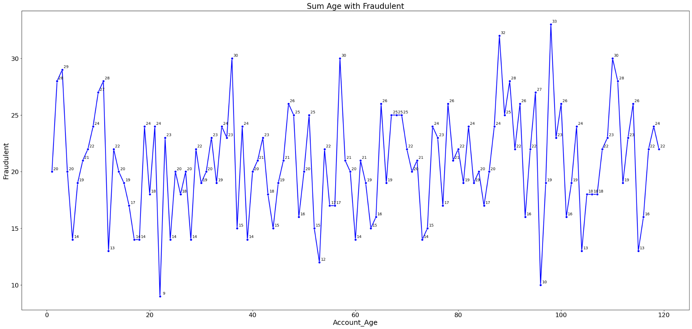
Exploratory Data Analysis (EDA)
4. How was the distribution of customer age with fraud ? is it more higher or low to get fraud ?
Insight :
As you can see, the more customer age getting older, the possibility for getting fraud is upside-down. The lowest on 22 years old with 9 persons (red). The highest is on 98 years old with 33 persons (green)

Slide 17
04
Modeling & Evaluation

Slide 18
Evaluation Metric
In this case, we’re gonna use Precision & Recall and ROC-AUC
 | Train (Precision & Recall) | Test (Precision & Recall) | Train (ROC-AUC) | Test (ROC-AUC)
Logistic Regression | 0.53 | 0.49 | 0.05 | 0.05
Random Forest | 0.53 | 0.48 | 0.05 | 0.05
XGBoost | 0.58 | 0.50 | 0.07 | 0.05
Decision Tree
Based on that table, the most saver or useable for the feature importance is on logistic regression. Because, the train and test in ROC-AUC and Precision-Recall is very small gap than the other models

Slide 19
Model & Evaluation Metric
In this case, we’re gonna use Precision & Recall and F1-Score
 | Train |  | Test
 | F1-Score | Precision- Recall | F1-Score | Precision- Recall
Logistic | 0.56 | 0.56 | 0.08 | 0.05
Decision Tree | 0.62 | 0.61 | 0.09 | 0.05
Random Forest | 0.52 | 0.53 | 0.08 | 0.05
XGBoost | 0.60 | 0.57 | 0.09 | 0.05
Based on that table, the most saver or useable for the feature importance is on Random Forest. Because, the train and test in F1-Score and Precision-Recall is smaller gap than the other models.

Slide 20
05
Feature Importance

Slide 21
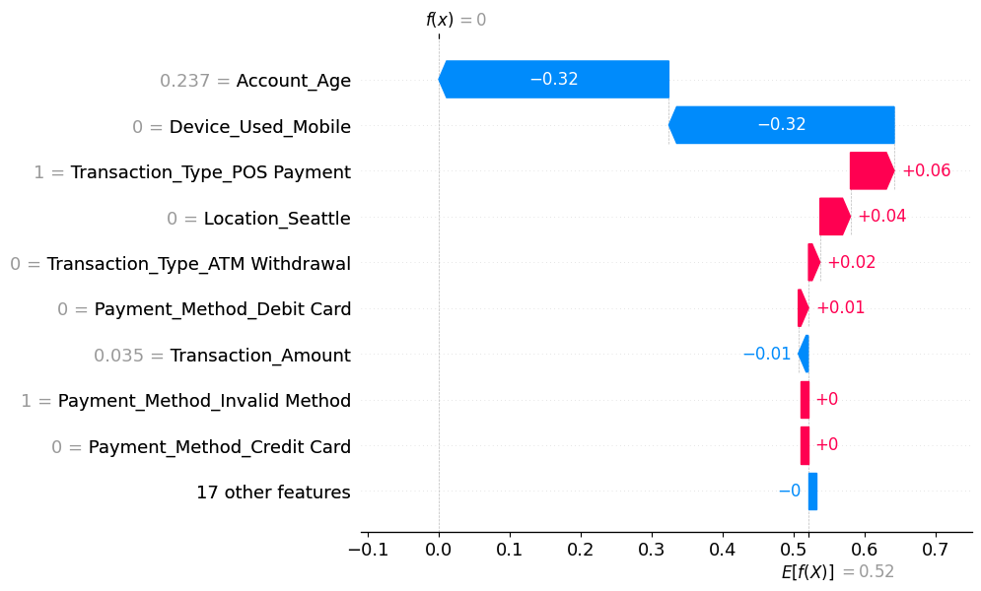
Feature Importance
After evaluation, the random forest is more acceptable rather than the other models. So, in this chapter, we’re gonna determined who is potentially getting fraud
Based on that waterfall, the probability to get fraud is getting lower from 0.52 into 0. But, some of features still had to be fraud for Location_Seattle, atm withdrawal, pos payment, and payment Debit Card is still fraud.

Slide 22
06
Conclusion & Recommendation

Slide 23
Conclusion
Primary Predictors : POS Payment, ATM Withdrawal, Seattle, and Debit Card
POS Payment .) the most effect to be fraud with increasing about 0.06 .) Also, the probability to be that transaction is exist.
ATM Withdrawal .) The third effect with fraud for 0.02 .) The probability to exist the ATM is None.
Seattle .) The secondary effect with 0.04 increment for fraud .) The condition / probability to exist fraud in seattle is None
Debit Card .) The weakest effect for fraud with 0.01 .) The possibly for exist in debit is None
Minor Predictors : Account Age, Device Mobile, Transaction Amount, and etc.
Account Age & Device Mobile .) the most effect to be not fraud with 0.32 .) the most age to be not fraud is on 28 years old .) the probability or exist of Mobile is None
Transaction Amount .) The last effect to be not fraud with 0.01 .) The total amount for not fraud is 1.749 $.

Slide 24
Recommendation
Based on that feature importance, there’s some of recommendation for lowering that fraudation. Here’s some tips :
Trying to be private when doing transaction (ATM Withdrawal & Debit Card)
Using geological verification and behavioral analysis, Making trial of pin in ATM with Max. 3 times, and using chip-based EMV card for avoiding magnetic stripe
Giving some protection in the office of bank (POS Payment)
Giving CCTV when the customer is doing transaction, Always rechecking if POS / ATM is detected skimmer, and always audit for security in some of merchant in Pos Payment
Avoid some of places that really suspected (Seattle)
Keeping up with law enforcer to investigate cybercrime in bank, Closing with hands for inputting the pin of ATM, Always updating the flow of fraud with each of banks in the real-time

